Slide 1
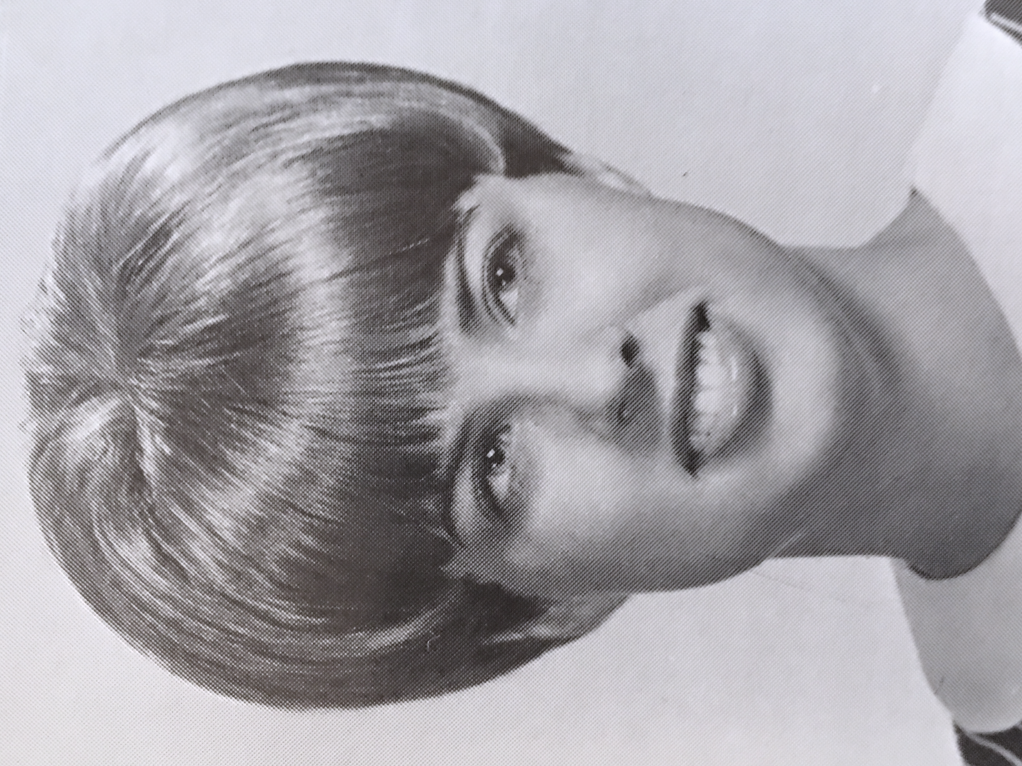
Karen Jaeger Andregg
Karen married Randy Andregg (Class of ‘69) in 1971 and graduated with a BS in Nursing from WWU in 1972.
They then moved to Southern California and Randy completed his Doctor of Optometry degree and Karen worked as an ER nurse during the 4 years.
They moved to Boise in 1977 and Randy began his Optometry practice. They have 2 daughters, who attended and graduated from Gem State. Emily married a local boy, Shawn Sates and have 2 children, Melissa lives in Texas with her husband and 2 children.
Karen worked 26 years at St. Luke’s Reginal Medical Center in Labor and Delivery, 10 years in management. She retired from nursing in 2005 and helped with Randy’s practice, took time to travel and are grateful for the blessings of her life and family.

